Slide 1
Comparative Analysis of Satellite & Ground‑Based Ozone Measurements
By: Sallam Saka
Supervisors: Professor Kaley Walker and Dr. Paul Jeffery

Slide 2
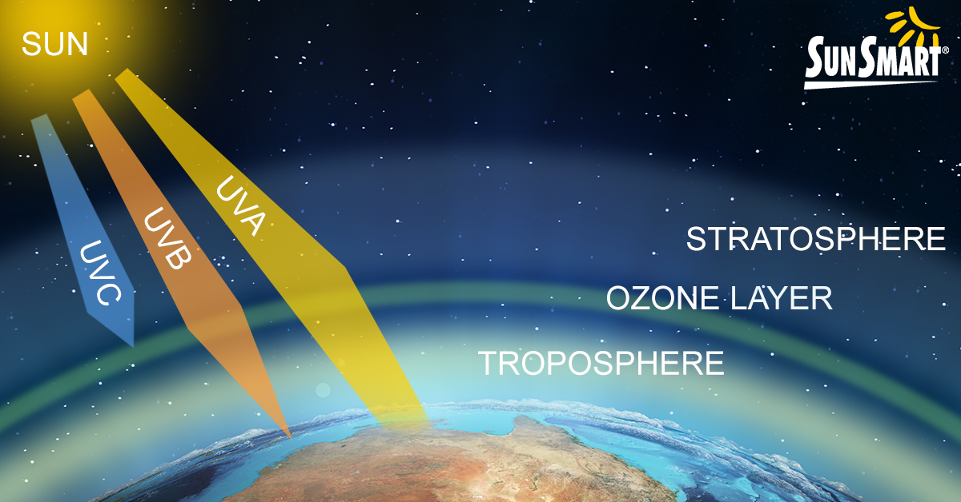
OZONE’S SIGNIFICANCE
Why Ozone Matters:
Critical UV shield for Earth
Impacts climate & ecosystems
Photochemically destroyed, causing seasonal ozone holes
Challenge: Instruments measure ozone differently which creates data uncertainty
Ross J. Salawitch, Laura A. McBride, Chelsea R. Thompson, Eric L. Fleming, Richard L. McKenzie, Karen H. Rosenlof, Sarah J. Doherty, David W. Fahey, Twenty Questions and Answers About the Ozone Layer: 2022 Update, Scientific Assessment of Ozone Depletion: 2022, 75 pp., World Meteorological Organization, Geneva, Switzerland, 2023.

Slide 3
Validating Ozone Data
Objective: Assess consistency of ozone data across ACE-FTS, OSIRIS, and PEARL FTIR
Approach: Compare individual and aggregated measurements of the instruments
Why This Work Matters:
Ensures reliable ozone data is consistently retrieved from instruments
Enables evidence-based policies (e.g., Montreal Protocol)

Slide 4
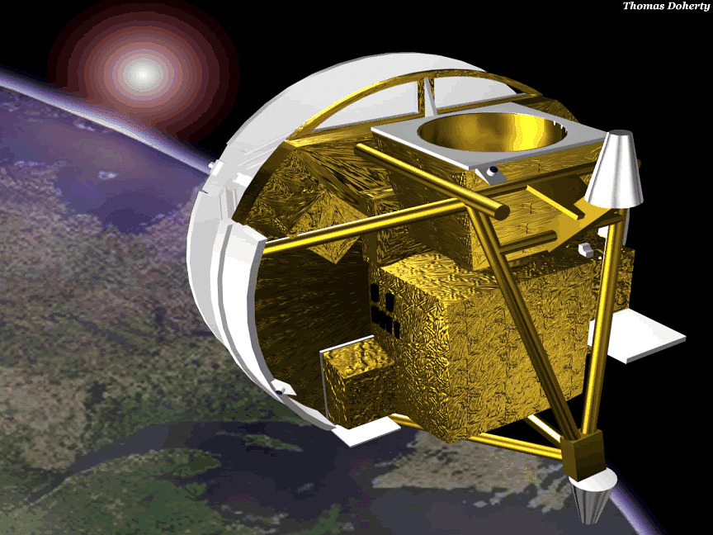
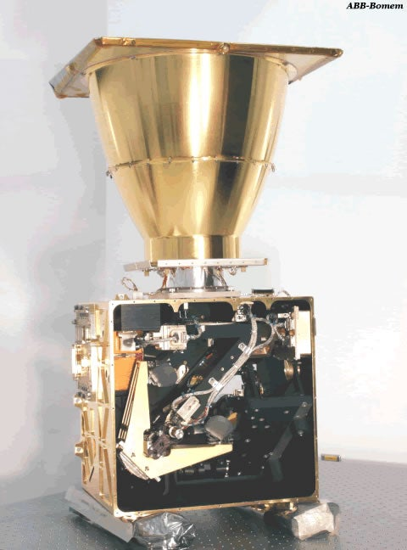
ACE-FTS
ACE-FTS stands for Atmospheric Chemistry Experiment Fourier Transform Spectrometer
ACE-FTS is one of the two main instruments on SCISAT
SCISAT was launched in 2003
ACE-FTS measures in the limb viewing geometry
ACE‑FTS applies Fourier transform to interferograms to yield absorption spectra
Bernath, P. F., et al. (2005), Atmospheric Chemistry Experiment (ACE): Mission overview, Geophys. Res. Lett., 32, L15S01, doi:10.1029/2005GL022386
https://uwaterloo.ca/atmospheric-chemistry-experiment/instruments/ace-fts
https://www.nasa.gov/image-article/scientific-satellite-atmospheric-chemistry-experiment-1-scisat-1/
Notes:
Vertical resolution of 4km

Slide 5
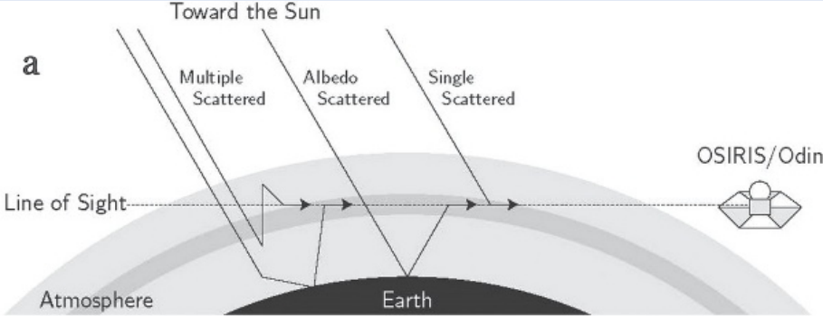
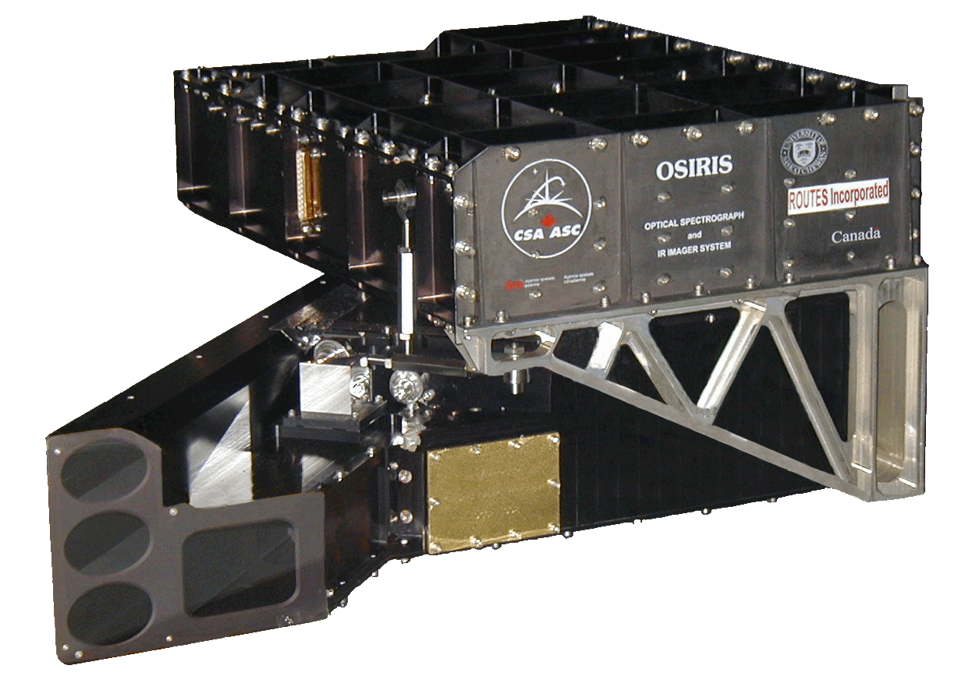
Osiris
OSIRIS stands for Optical Spectrograph and InfraRed Imaging System
OSIRIS is on-board the Odin satellite
Odin was launched in 2001
OSIRIS is also pointed toward the limb of earth’s atmosphere
IRI observes both scattered sunlight and airglow emission
OS obtains spectra of scattered sunlight
McLinden, C. A., and Coauthors, 2012: OSIRIS: A Decade of Scattered Light. Bull. Amer. Meteor. Soc., 93, 1845–1863, https://doi.org/10.1175/BAMS-D-11-00135.1
Llewellyn, E. J., et al. 2004. The OSIRIS instrument on the Odin spacecraft. Canadian Journal of Physics. 82(6): 411-422. https://doi.org/10.1139/p04-005
Notes:
Vertical resolution of 1-2km depending on altitude

Slide 6
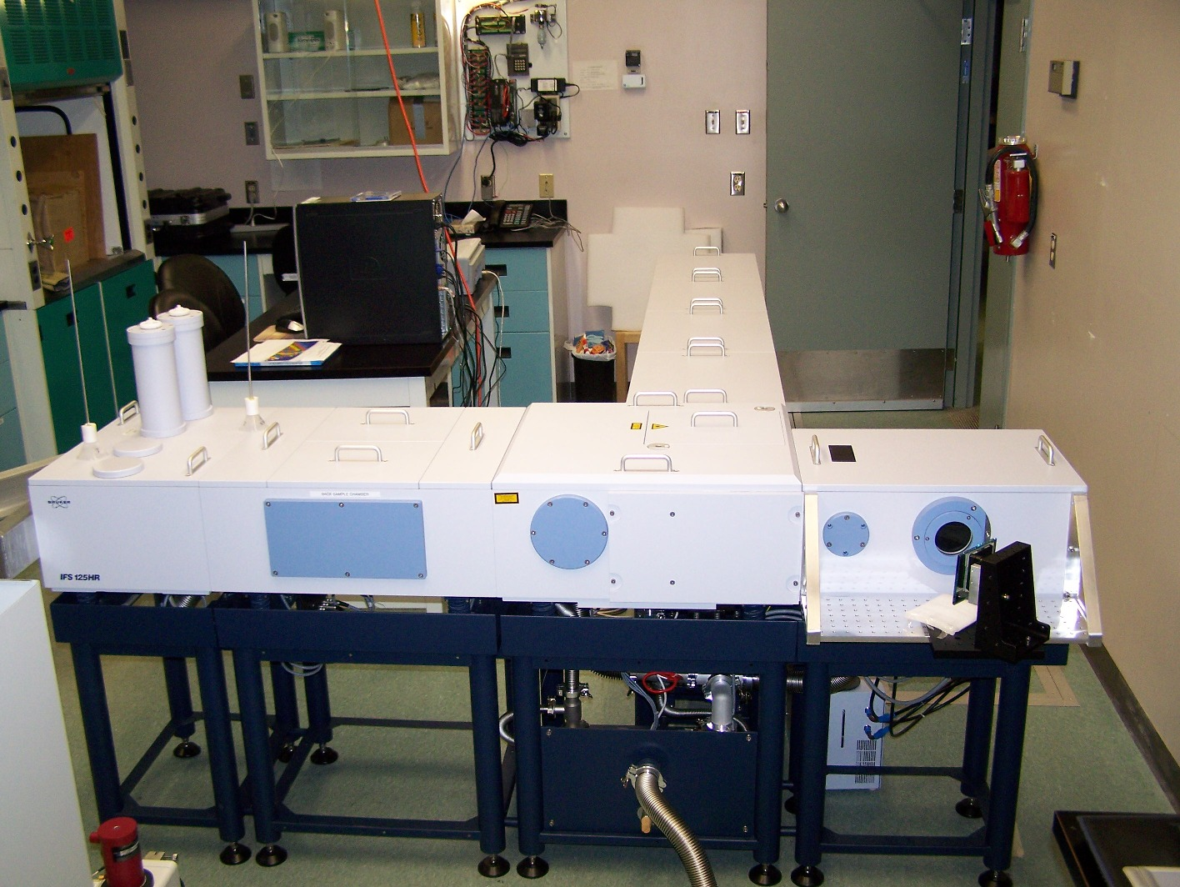
PEARL FTIR
PEARL FTIR stands for Polar Environment Atmospheric Research Laboratory Fourier-Transform Infra-Red Spectrometer
PEARL FTIR is a ground-based instrument
PEARL FTIR is also known as Bruker FTIR
Installed permanently at PEARL in July, 2006
Measures atmospheric solar absorption while the sun has risen
https://eureka.physics.utoronto.ca/Eureka2020/Our_Instruments.html

Slide 7
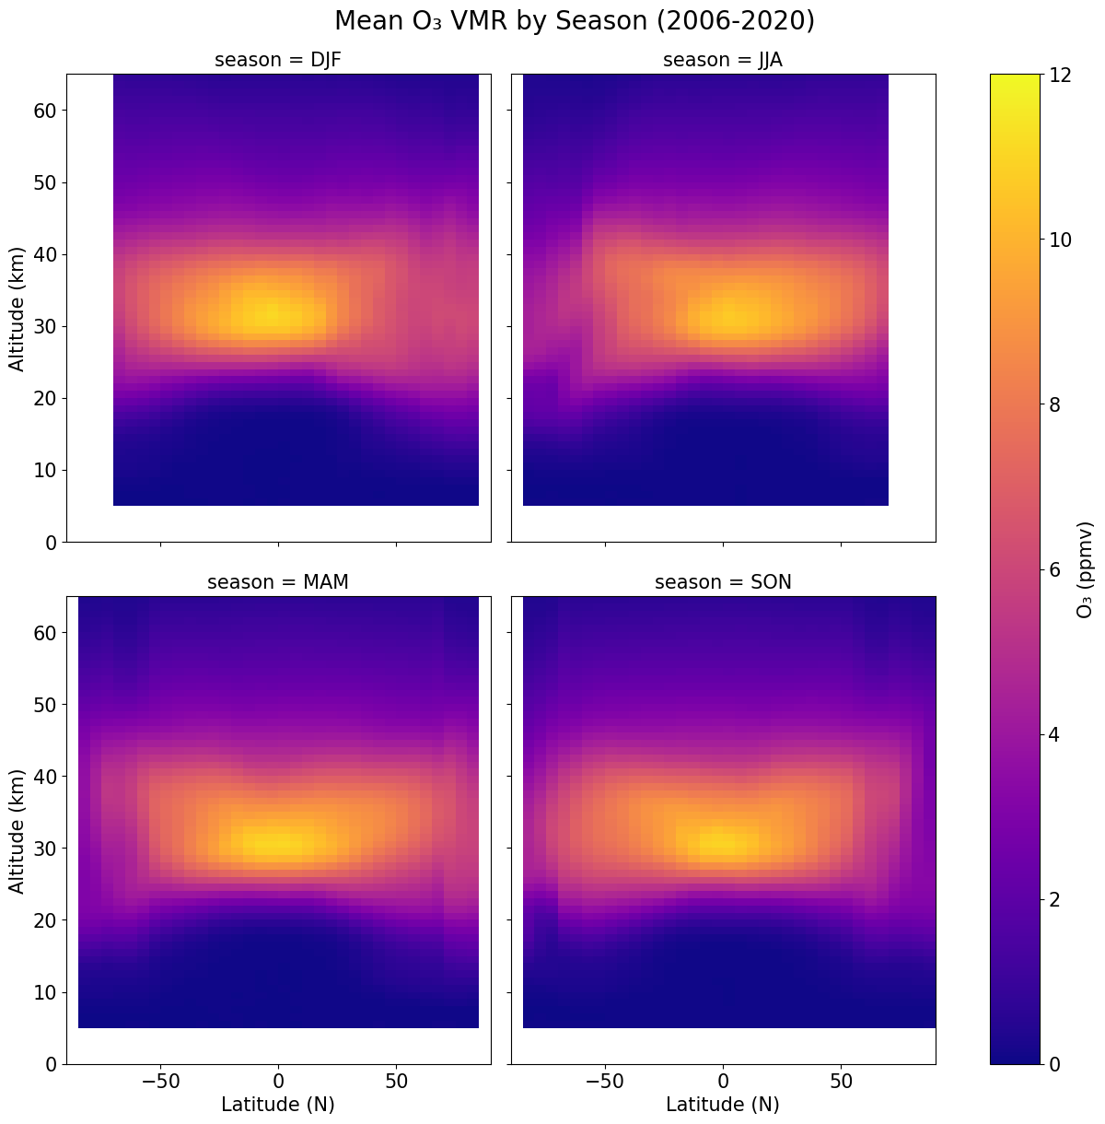
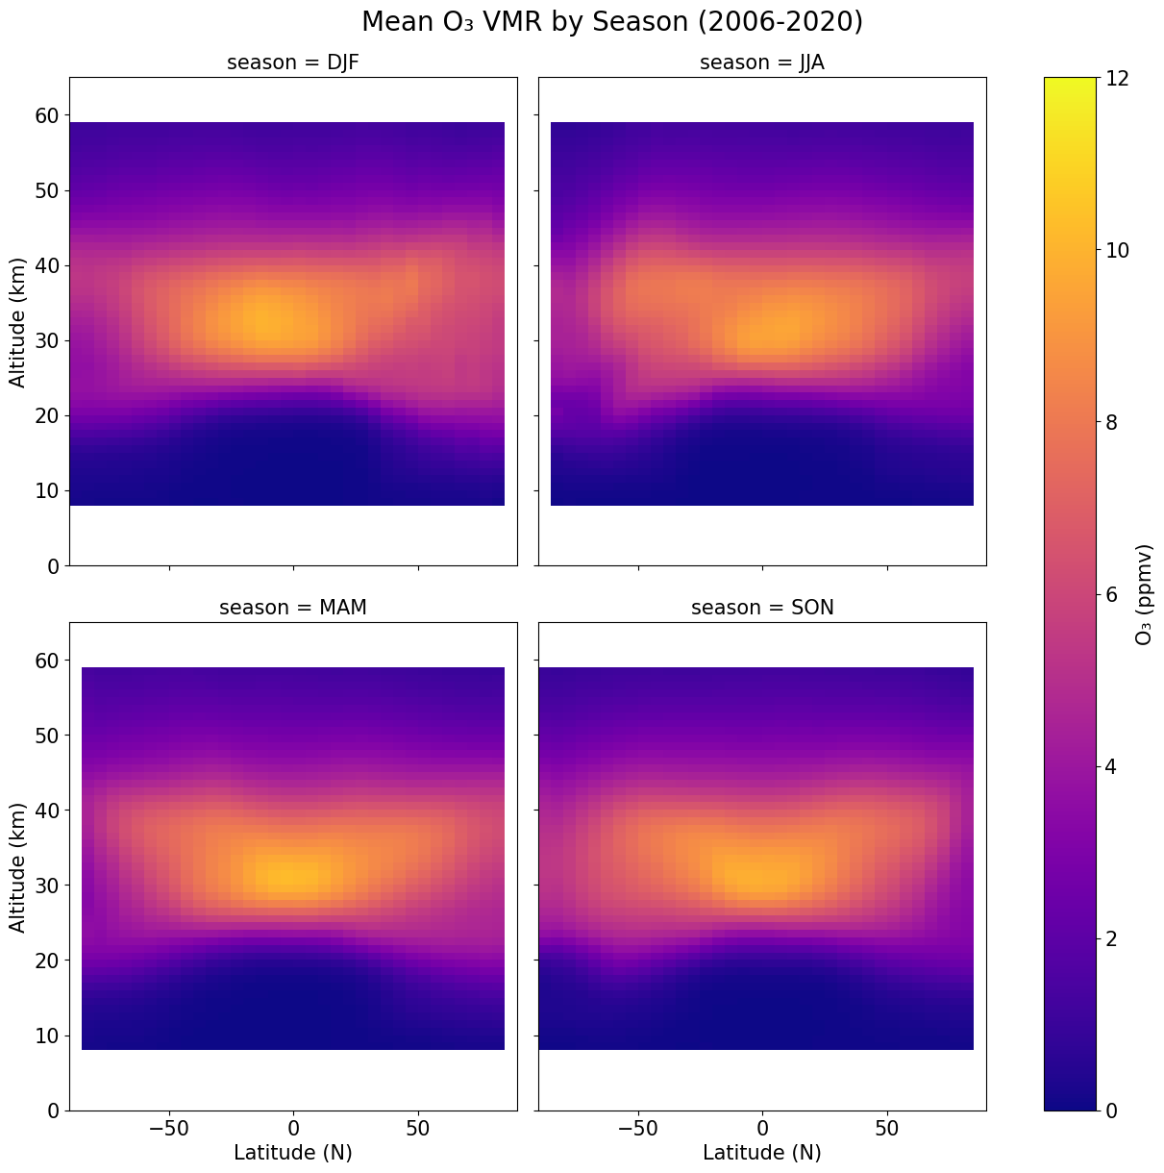
ACE-FTS
OSIRIS

Slide 8
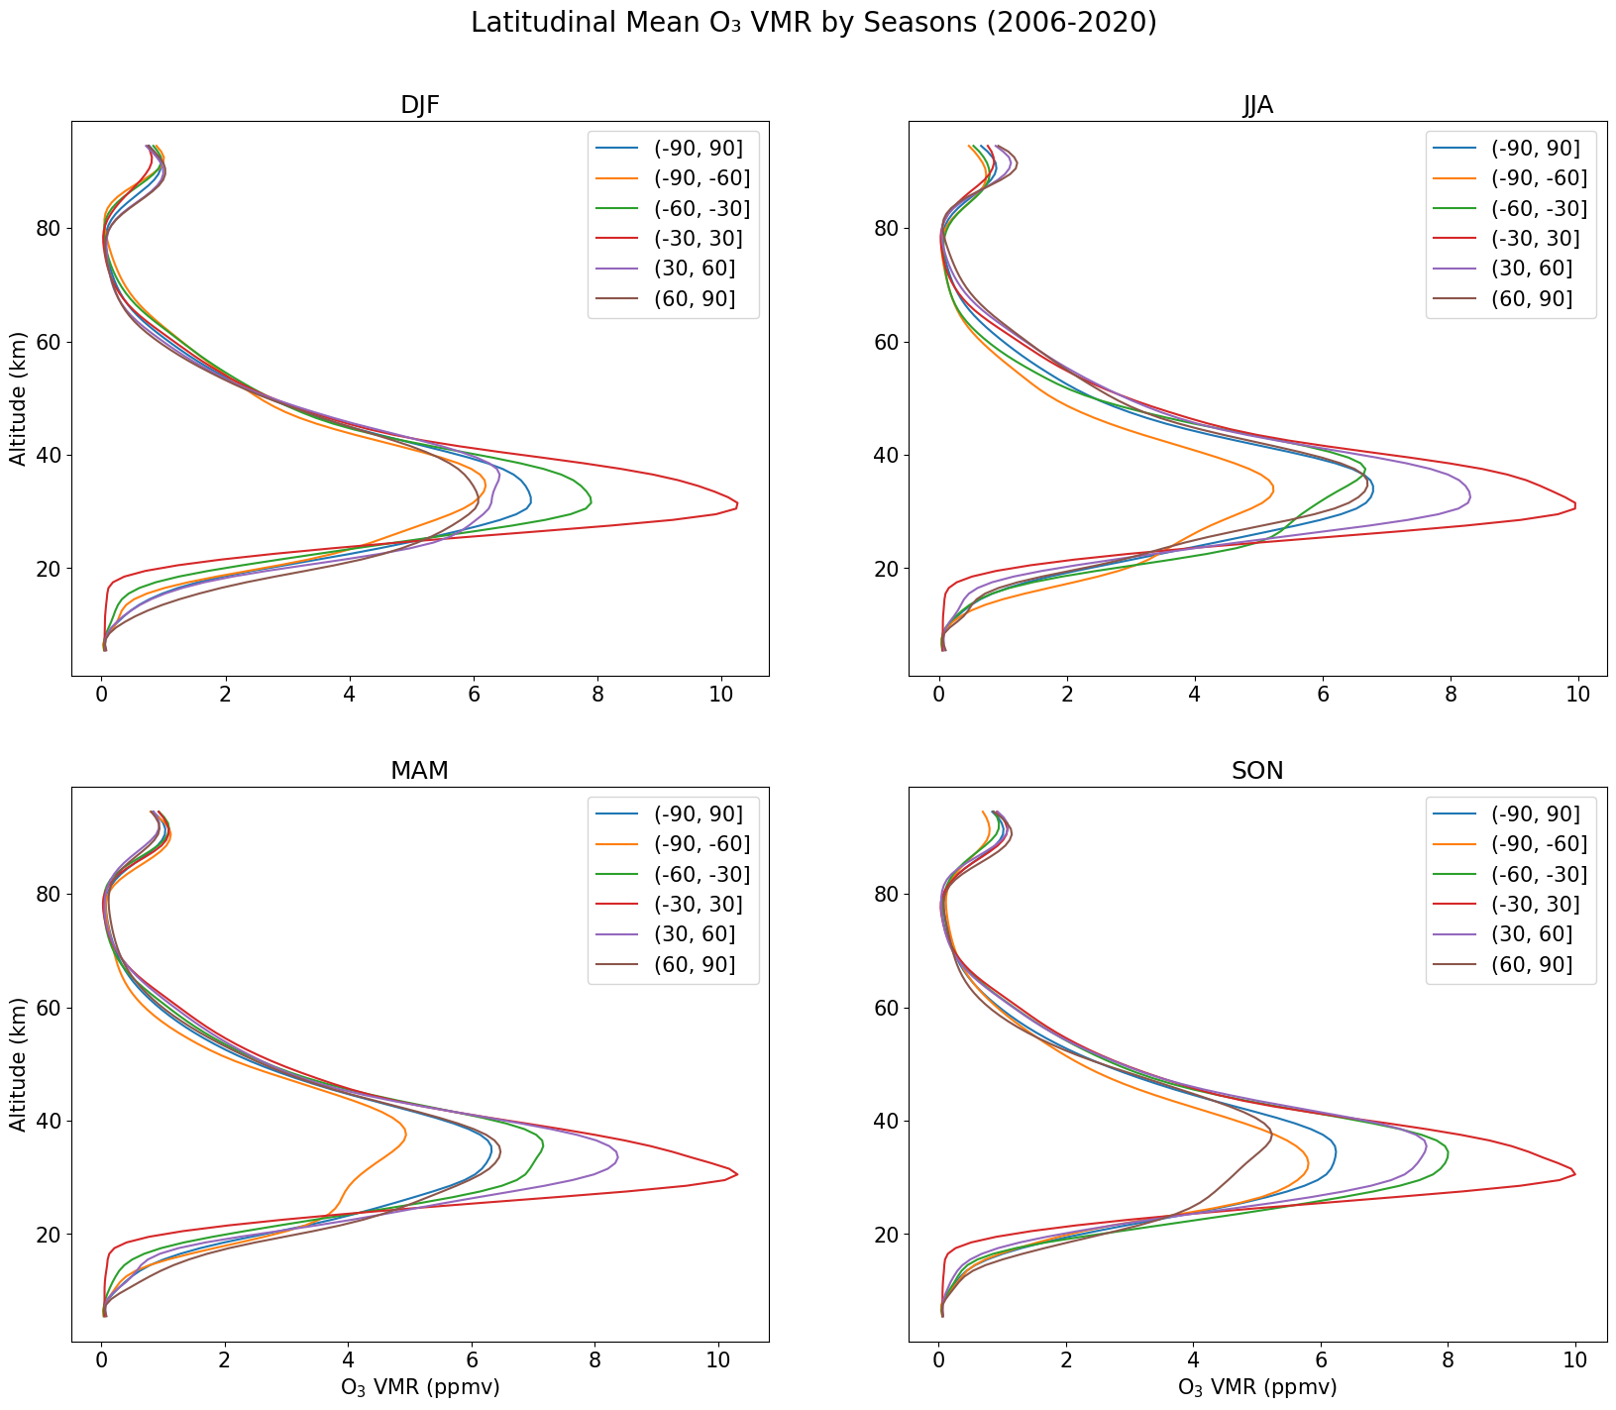
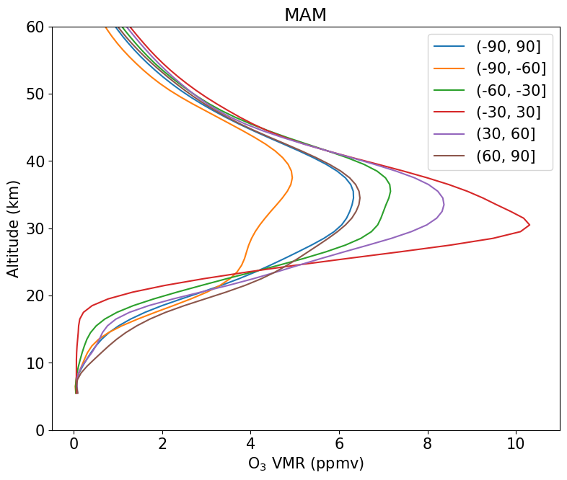
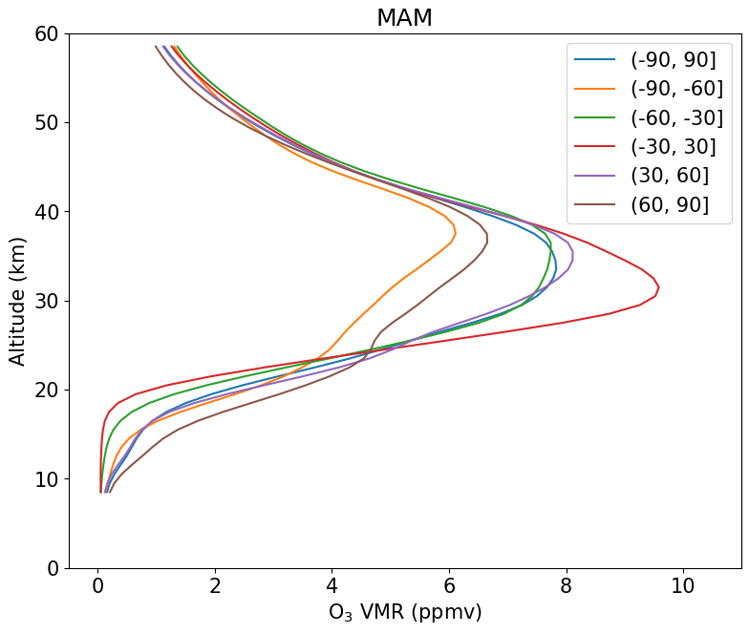
ACE-FTS
Osiris vs ace-fts PLOT DISCREPANCY
OSIRIS
Notes:
Yellow line, then green line

Slide 9
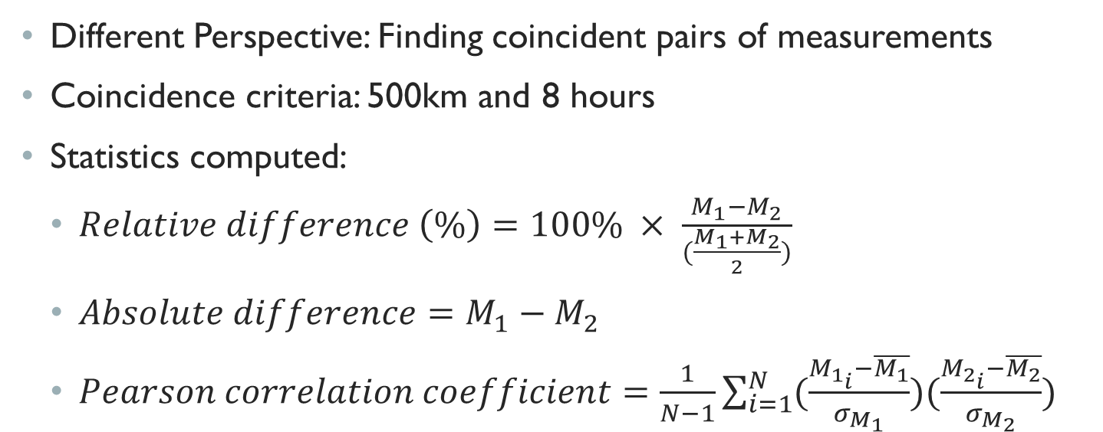
INDIVIDUAL MEASUREMENT COMPARISONS
Different Perspective: Finding coincident pairs of measurements
Coincidence criteria: 500km and 8 hours
Statistics computed:
$Relative difference \left(\%\right)=100\% × \frac{M_{1}−M_{2}}{(\frac{M_{1}+M_{2}}{2})}$
$Absolute difference=M_{1}−M_{2}$
$Pearson correlation coefficient=\frac{1}{N−1}\sum_{i=1}^{N}{(\frac{M_{1_{i}}−\overline{M_{1}}}{σ_{M_{1}}})(\frac{M_{2_{i}}−\overline{M_{2}}}{σ_{M_{2}}})}$

Slide 10
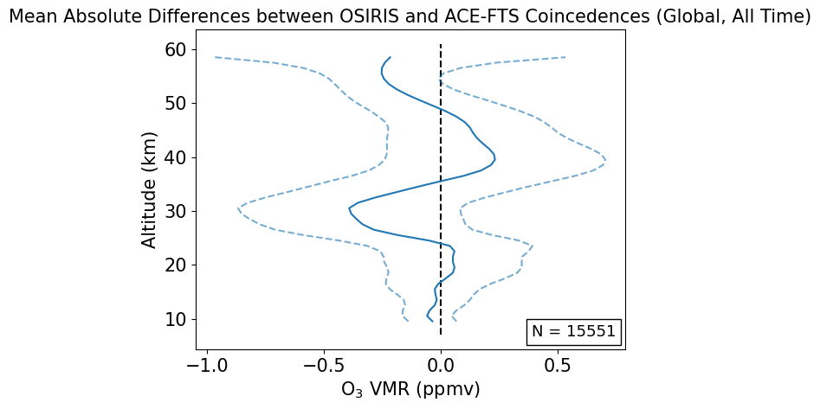
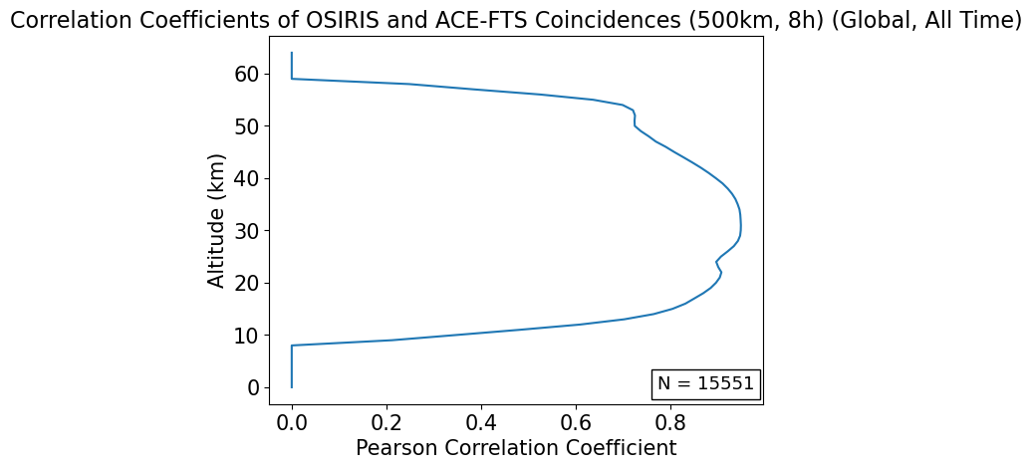
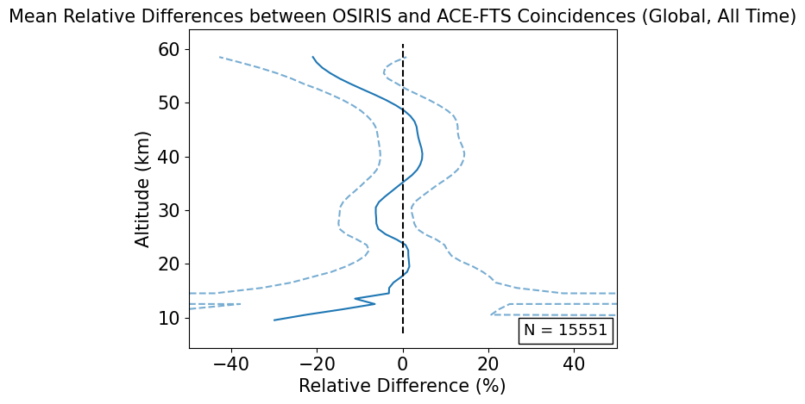
OSIRIS vs ACE-FTS OZONE PROFILE PLOTS

Slide 11
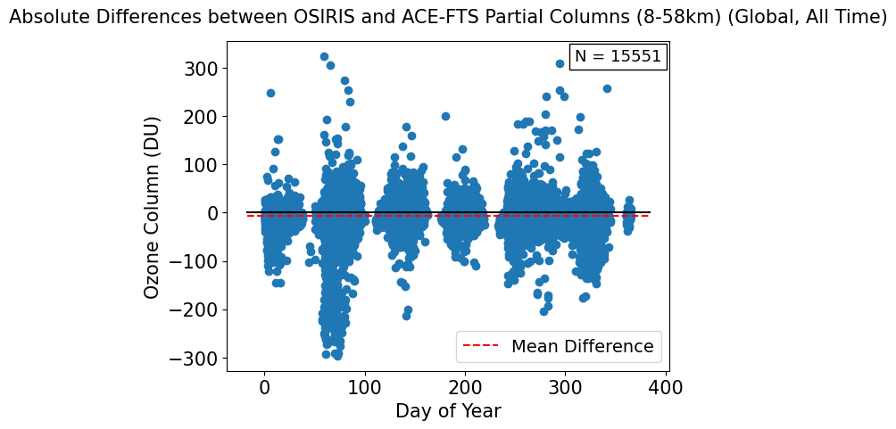
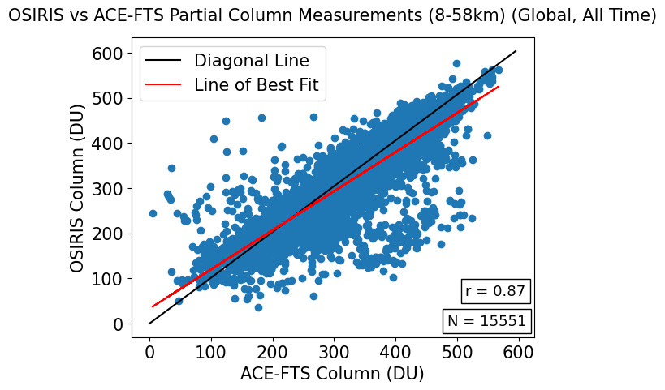
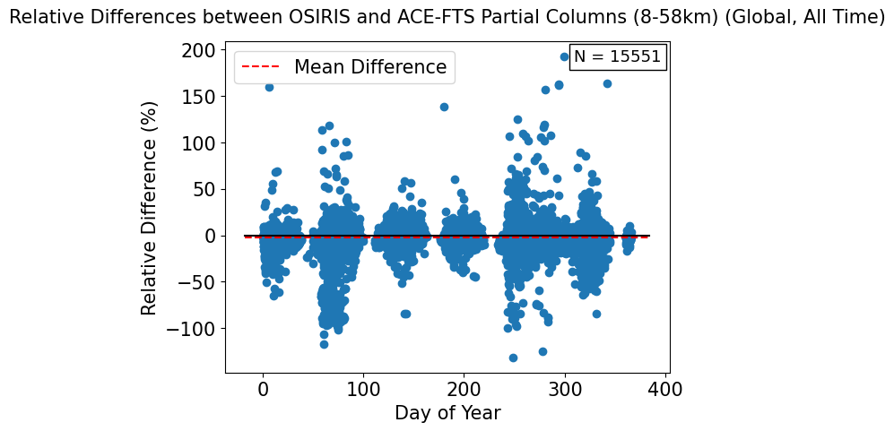
OSIRIS vs ACE-FTS OZONE Partial COLUMN PLOTS

Slide 12
POTENTIAL Next stepS
Analysis of the Averaging Kernels of the PEARL FTIR instrument to allow for more accurate comparisons
Refining coincidence criteria
Examining seasonality of agreement
Examining agreement overtime

Slide 13
REFERENCES
Bernath, P. F., et al. (2005), Atmospheric Chemistry Experiment (ACE): Mission overview, Geophys. Res. Lett., 32, L15S01, doi:10.1029/2005GL022386
McLinden, C. A., and Coauthors, 2012: OSIRIS: A Decade of Scattered Light. Bull. Amer. Meteor. Soc., 93, 1845–1863, https://doi.org/10.1175/BAMS-D-11-00135.1
Llewellyn, E. J., et al. 2004. The OSIRIS instrument on the Odin spacecraft. Canadian Journal of Physics. 82(6): 411-422. https://doi.org/10.1139/p04-005
https://eureka.physics.utoronto.ca/Eureka2020/Our_Instruments.html
https://uwaterloo.ca/atmospheric-chemistry-experiment/instruments/ace-fts
Ross J. Salawitch, Laura A. McBride, Chelsea R. Thompson, Eric L. Fleming, Richard L. McKenzie, Karen H. Rosenlof, Sarah J. Doherty, David W. Fahey, Twenty Questions and Answers About the Ozone Layer: 2022 Update, Scientific Assessment of Ozone Depletion: 2022, 75 pp., World Meteorological Organization, Geneva, Switzerland, 2023.
https://www.nasa.gov/image-article/scientific-satellite-atmospheric-chemistry-experiment-1-scisat-1/

Slide 14

ANY QUESTIONS?

